Slide 1



Erick Garcia

Slide 2
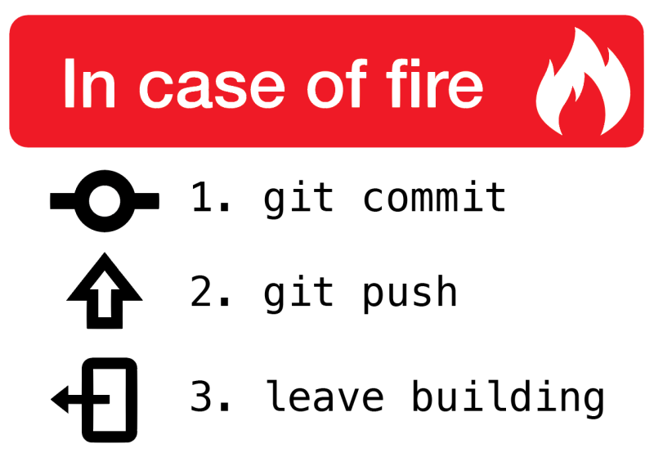
Git
Git is the most commonly used version control system today and is quickly becoming the standard for version control. Git is a distributed version control system, meaning your local copy of code is a complete version control repository.
Fig. 1: Standard git procedures in case of emergency

Slide 3
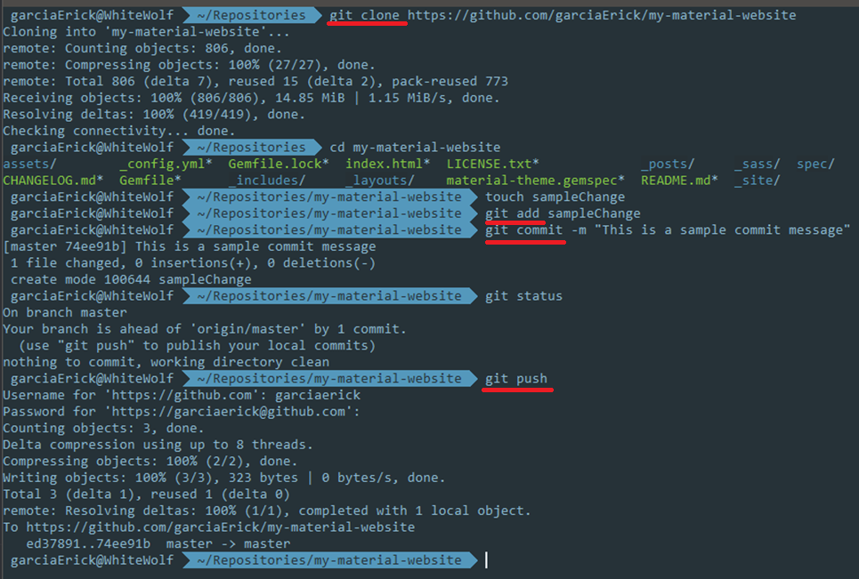


Slide 4
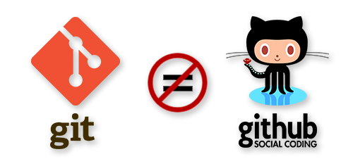
What is ?
Git is a command line tool, and GitHub is a website that allows users to use it as a storage area for their projects, an online repository
Other alternatives include BitBucket, and Microsoft Team Foundation Server
Fig. 2: Git vs. GitHub

Slide 5
Why should you care?
It’s used in industry
Showcase skills
Employers care that you are also active outside school/workplace
It is free for public repos
Large community
GitHub Pages

Slide 6
GitHub Pages
GitHub Pages is a static site hosting service.
Designed to host your personal, organization, or project pages directly from a GitHub repository
Does not support PHP, Ruby or Python code
Free domain name and host
Easy as creating a repository <YOUR-USERNAME>.github.io
You can use custom domains
You can use Jekyll as the engine with online themes

Slide 7
Jekyll
Jekyll is a simple, blog-aware, static site generator perfect for personal, project, or organization sites.
Jekyll is the engine behind GitHub pages, which you can use to host sites right from your GitHub repositories.
To test out your Jekyll site locally check out the installation instructions here

Slide 8
Get started
Create/Fork a repository
Set the source of the GitHub pages to the master branch
Edit config.yml
Create a CNAME file for the custom domain name if necessary
DONE! Your page should be live shortly

Slide 9
References
What is GitHub pages?
Getting Started on GitHub pages
My Resume generated by GitHub
Use Json to generate your resume
https://erick-garcia/
https://erick-garcia/online-cv/
http://jekyllthemes.org/

